Slide 1
THE WISDOM OF WORK
PROVERBS 30:24-28
PROVERBS 26:13-16

Slide 2
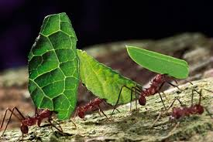
God Made Animals to Work
ANTS
PROV. 30:25
The ants are a people not strong, yet they prepare their food in the summer;

Slide 3
Ants – Prov. 6:6-11
Go to the ant, you sluggard! Consider her ways and be wise, which, having no captain, overseer or ruler, provides her supplies in the summer, and gathers her food in the harvest.
How long will you slumber, O sluggard? When will you rise from your sleep? A little sleep, a little slumber, a little folding of the hands to sleep — so shall your poverty come on you like a prowler, and your need like an armed man.

Slide 4
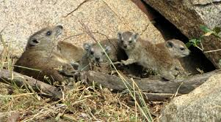
God Made Animals to Work
HYRAXES PROVERBS 30:26
The rock badgers are a feeble folk, yet they make their homes in the crags;

Slide 5
Building a Home - Prov 24:30-34
I went by the field of the lazy man, and by the vineyard of the man devoid of understanding; and there it was, all overgrown with thorns; its surface was covered with nettles; its stone wall was broken down.
When I saw it, I considered it well; I looked on it and received instruction: a little sleep, a little slumber, a little folding of the hands to rest; so shall your poverty come like a prowler, and your need like an armed man.

Slide 6
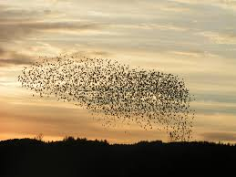
God Made Animals to Work
LOCUSTS
PROV. 30:27
The locusts have no king, yet they all advance in ranks;

Slide 7
Following God’s Orders – Joel 2:7-10
They run like mighty men, they climb the wall like men of war; every one marches in formation, and they do not break ranks. They do not push one another; every one marches in his own column. Though they lunge between the weapons, they are not cut down. They run to and fro in the city, they run on the wall; they climb into the houses, they enter at the windows like a thief.
The earth quakes before them, the heavens tremble; the sun and moon grow dark, and the stars diminish their brightness.

Slide 8
Following God’s Orders – Joel 2:11,25
The Lord gives voice before His army, for His camp is very great; for strong is the One who executes His word. For the day of the Lord is great and very terrible; who can endure it?
v.25 So I will restore to you the years that the swarming locust has eaten,
The crawling locust,
The consuming locust,
And the chewing locust,
My great army which I sent among you.

Slide 9
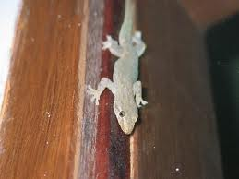
God Made Animals to Work
LIZARD PROV. 30:28
The spider skillfully grasps with its hands, And it is in kings' palaces.

Slide 10
Excel in Work – Prov. 22:29
Do you see a man who excels in his work? He will stand before kings; he will not stand before unknown men.
31:13 She seeks wool and flax, and willingly works with her hands…15 She also rises while it is yet night, and provides food for her household, and a portion for her maidservants…17 She girds herself with strength, and strengthens her arms.
18 She perceives that her merchandise is good, and her lamp does not go out by night…27 She watches over the ways of her household, and does not eat the bread of idleness.

Slide 11
God Made Man to Work
Gen. 2:15 to tend and keep the garden
Ephesians 4:28 Let him who stole steal no longer, but rather let him labor, working with his hands what is good, that he may have something to give him who has need.
Colossians 3:20-25
Deut. 15:28 It shall not seem hard to you when you send him away free from you; for he has been worth a double hired servant in serving you six years.

