Slide 1
THE SHUNAMMITE WOMAN
2 KINGS 4:8-37

Slide 2
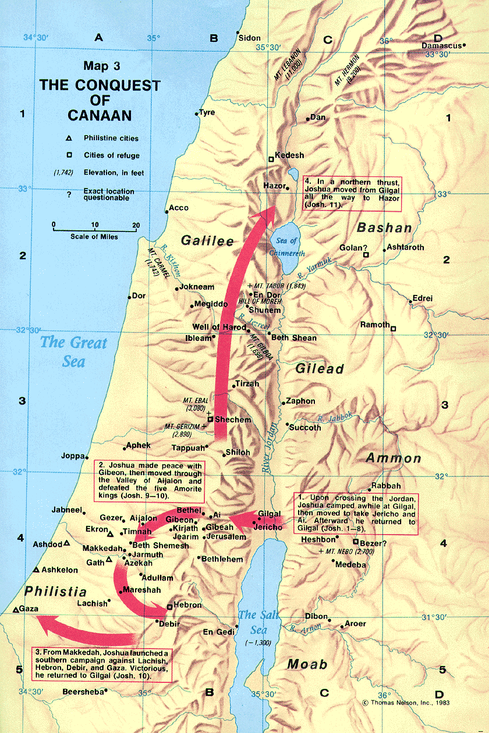

Slide 3
The Shunammite Woman
2 Kings 4:8-37
A notable woman v.8
A hospitable woman v.8, Heb. 13:2; 1 Peter 4:9
A considerate woman v.10, 13; 1 Cor. 13:4
A content woman v.13; Phil. 4:11; 1 Tim. 6:6-10
A childless woman v.14 Sarah, Rachel, Hannah, Elisabeth, Manoah’s wife
A doubtful woman v.16, Genesis 18:10-15
A blessed woman v.17; Psalm 127
A caring mother v.20; 1 Thessalonians 2:7-8

Slide 4
The Shunammite Woman
2 Kings 4:8-37
A faithful woman in the face of loss and grief v.21-25
A calm woman “It is well”
A clueless husband v.19,23,9
A loyal woman v.30, Luke 22:31-34
A grateful woman v.37, Luke 17:11-19
A rewarded woman 2 Kings 8:1-6, Eccl. 11:1-2
God will reward you according to your deeds
God will treat you as you treat others Psalm 18

