Slide 1
THE BIBLE
A SPECIAL BOOK

Slide 2
THE BIBLE: a Special Book
A variety of writers forty different men contributed to the collection of 66 books
A variety of backgrounds kings, shepherds, priests, fishermen
A variety of places Jerusalem, Rome, Babylon
A variety of times from 1450 B.C. till A.D. 95
Three different languages Hebrew, Aramaic, Greek
NO CONTRADICTIONS
Perfect unity requires a single source

Slide 3
We Can Trust That We Have God’s Message for Us Today
A standard of Old Testament inspiration existed in the process of developing the Old Testament Ezekiel 13:9
The Jews accepted 39 books as God’s word
So did Jesus Matthew 5:17-20
The New Testament books also went through a very careful process of revelation through the apostles and confirmed by those on whom they laid their hands 1 Corinthians 14:37

Slide 4
We Can Trust The Bible’s Historical Accuracy
Extra-biblical references to Bible events
1 Kings 14:25-26 Campaign into Israel by Pharaoh Shishak recorded on the walls of the Temple of Amun in Thebes, Egypt.

Slide 5
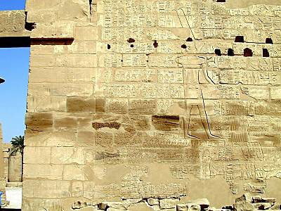
Temple of Amun

Slide 6
We Can Trust The Bible’s Historical Accuracy
2 Kings 1:1; 3:4-27 Revolt of Moab against Israel recorded on the Mesha Inscription.

Slide 7
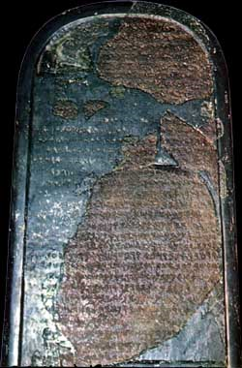
The Mesha Stele

Slide 8
We Can Trust The Bible’s Historical Accuracy
2 Kings 17:3-6, 24; 18:9-11 Fall of Samaria to Sargon II, king of Assyria, as recorded on his cuneiform prism.
Isaiah 20:1 Defeat of Ashdod by Sargon II as recorded on his palace walls.

Slide 9
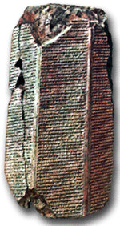
Sennacherib’s Defeat of Samaria

Slide 10
We Can Trust The Bible’s Historical Accuracy
Extra-biblical references to Bible events
2 Kings 18:13-16 Campaign of the Assyrian king Sennacherib against Judah recorded on the Taylor Prism.

Slide 11
The Taylor Prism

Slide 12
We Can Trust The Bible’s Historical Accuracy
2 Kings 18:14, 17 Siege of Lachish by Sennacherib recorded on the Lachish reliefs.
2 Kings 19:37 Assassination of Sennacherib by his own sons is recorded in the annals of his son Esarhaddon.

Slide 13
Lachish Reliefs in Sennacherib’s Palace

Slide 14
We Can Trust The Bible’s Historical Accuracy
Extra-biblical references to Bible events
2 Kings 24:10-14 Nebuchadnezzar’s conquest of Jerusalem is recorded in the Babylonian Chronicles.
2 Kings 24:15-16 Captivity of Jehoiachin, king of Judah, is recorded on the Babylonian Ration Records.
Daniel 5:30-31 Fall of Babylon to the Medes and Persians is recorded on the Cyrus Cylinder.
Ezra 1:1-4; 6:3-4 Freeing of captives in Babylon by Cyrus the Great is recorded on the Cyrus Cylinder.

Slide 15
The Cyrus Cylinder

Slide 16
We Can Trust The Bible’s Historical Accuracy
Extra-biblical mention of N.T. events & people
Acts 18:2 Jews are banished from Rome by the Emperor Claudius recorded by Suetonius
Luke 1:1-4, 2:1-2 Jesus is a true historical person
Several unsympathetic witnesses to historicity of Jesus: Suetonius, Thallus, Pliny the Younger, Lucian, Josephus
Romans 16:23 Erastus (Corinth treasurer) has name written in Corinthian ruins

Slide 17
The Erastus Inscription

Slide 18
Truth
The Bible is a book of truth
God’s word
God cannot lie Titus 1:2
Historical truth proves Bible’s truthfulness
Contains spiritual truth
This truth sets us free when we know it and abide in it John 8:31-32
Obey His word today!

