Slide 1
THE BEGINNING
GENESIS 1-11

Slide 2
The Beginning
In the beginning God created the Heavens and the earth
The earth was without form and void
The Spirit of God hovered over the waters
And God said Psalm 33:6-9
Let there be light
The first day is the beginning of time
1. Evening + morning → day

Slide 3
The Beginning
2. Firmament separated water above it from water below it
3. Separation of water under the firmament from the land; vegetation produces according to their various kinds
4. Heavenly bodies to mark time
5. Birds and fish
6. All the land creatures and man

Slide 4
God Created Man in His Image
Genesis 1:26: Then God (pl.) said, (sing.) “Let Us make (pl.) man (sing.) in Our (pl.) image, (sing.) according to Our (pl.) likeness; (sing.) let them (pl.) have dominion…” (pl.) v.27: So God (pl.) created (sing.) man (sing.) in His (sing.) own image; (sing.) in the image (sing.) of God (pl.) He created (sing.) him; (sing.) male (sing.) and female (sing.) He created (sing.) them. (pl.)

Slide 5
God Created Man in His Image
In Our image = in His image
In God’s image = plurality in one
Created man = created him = created them
Man is plurality in one (male and female)
V.26 God (Elohim pl.) said (sing.); v.27 God (pl.) created (sing.)
Unity in thought and action
Genesis 2:18-25 God made us different to learn to appreciate each other

Slide 6
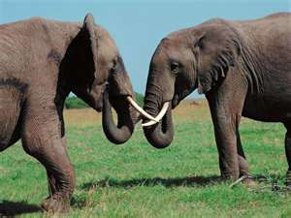

Slide 7
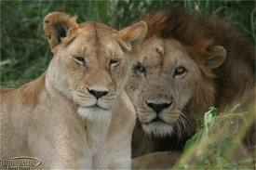

Slide 8
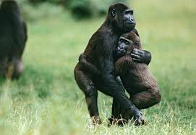

Slide 9
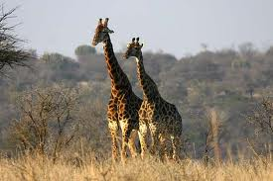

Slide 10
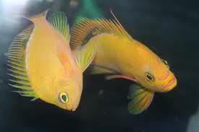

Slide 11
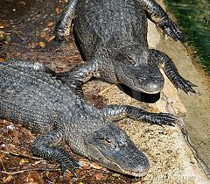

Slide 12
God’s Design for Man
This is now… v.23
Oneness of spirit v.24
Expressed in oneness of flesh v.24
God is a relational being; God is love 1 John 4:8
Created us for fellowship with Him by faith
Created us to love Him and each other
Made different to learn to consider the other 1 Cor. 12, Col. 3:15

