Slide 1
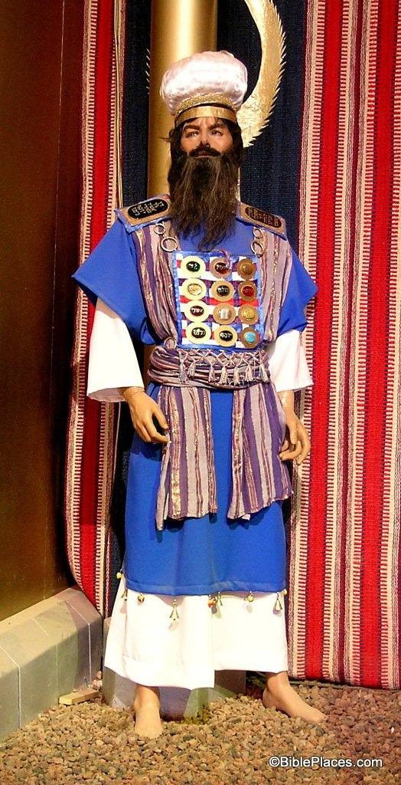
PREREQUISITES OF A HIGH PRIEST
HEBREWS 5:1-10

Slide 2
Prerequisites of a High Priest Hebrews 5:1-10
v.1 RESPONSIBILITY
v.2-3 SYMPATHY
v.4 AUTHORITY
v.5-6 AUTHORITY
v.7-8 SYMPATHY
v.9-10 RESPONSIBILITY

Slide 3
Prerequisites of a High Priest Hebrews 5:1-10
v.1 RESPONSIBILITY
Appointed for men—
to represent men to God
Offer gifts to God for men
Offer sacrifices for sins of men to God
v.2-3 SYMPATHY
Compassion for the ignorant & the lost
He is subject to weakness
GOD
MAN

Slide 4
Prerequisites of a High Priest Hebrews 5:1-10
v.2-3 SYMPATHY
He sinned and must sacrifice for his sins
v.4 AUTHORITY
No man can make himself priest 1 Kings 12:31; 2 Chronicles 13:9
Must be called by God (by His word) Numbers 18:7; 2 Chronicles 26:16-21; Hebrews 7:14

Slide 5
Prerequisites of a High Priest Hebrews 5:1-10
v.5-6 AUTHORITY
Christ did not glorify Himself
God did by His word to Jesus v.6,10; Psalm 110:4
by a greater word (God’s oath) than the law of a fleshly commandment 7:16,20
v.7-8 SYMPATHY
in the days of His flesh—Jesus partook of flesh and blood → merciful 2:9-18

Slide 6
Prerequisites of a High Priest Hebrews 5:1-10
v.7-8 SYMPATHY
Jesus shared in flesh and blood → merciful high priest to help us 2:9-18
He suffered temptation without sin 4:15
He learned obedience by suffering
v.9-10 RESPONSIBILITY
Being perfected → author of salvation to all who obey Him 7:25; 9:24-28; 10:19-25

